Slide 1
Class 18 - File System Performance
Osama Hosam Eldeen
Taiba University

Slide 2
Improving file system performance
Memory mapped files
  Avoid system call overhead
Buffer cache
  Avoid disk I/O overhead
Careful data placement on disk
  Avoid seek overhead
Log structured file systems
  Avoid seek overhead for disk writes (reads hit in buffer cache)

Slide 3
Memory-mapped files
Conventional file I/O
  Use system calls (e.g., open, read, write, ...) to move data from disk to memory
Observation
  Data gets moved between disk and memory all the time without system calls
    Pages moved to/from PAGEFILE by VM system
  Do we really need to incur system call overhead for file I/O?

Slide 4
Memory-mapped files
Why not “map” files into the virtual address space
  Place the file in the “virtual” address space
  Each byte in a file has a virtual address
To read the value of a byte in the file:
  Just load that byte’s virtual address
    Calculated from the starting virtual address of the file and the offset of the byte in the file
  Kernel will fault in pages from disk when needed
To write values to the file:
  Just store bytes to the right memory locations
Open & Close syscalls → Map & Unmap syscalls

Slide 5
Memory-mapped files
Virtual Address Space
Stack
File on Disk
Text
&
Data

Slide 6
Memory-mapped files
“Map” syscall is made
Virtual Address Space
Stack
File on Disk
Text
&
Data

Slide 7
Memory-mapped files
“Map” syscall is made
Virtual Address Space
Stack
File on Disk
Text
&
Data

Slide 8
Memory-mapped files
“Map” syscall is made
Virtual Address Space
Stack
File on Disk
Text
&
Data

Slide 9
Memory-mapped files
“Map” syscall is made
Virtual Address Space
Stack
File on Disk
Text
&
Data
Demand Paging:
Only read pages when needed

Slide 10
File system performance
So how does memory mapping a file affect performance?

Slide 11
Buffer cache
Observations:
  Once a block has been read into memory it can be used to service subsequent read/write requests without going to disk
  Multiple file operations from one process may hit the same file block
  File operations of multiple processes may hit the same file block
Idea: maintain a “block cache” (or “buffer cache”) in memory
  When a process tries to read a block check the cache first

Slide 12
Buffer cache
Cache organization:
  Many blocks (e.g., 1000s)
  Indexed on block number
key
device block#

Slide 13
Buffer cache
Cache organization:
  Many blocks (e.g., 1000s)
  Indexed on block number
For efficiency,
  use a hash table
key
device block#

Slide 14
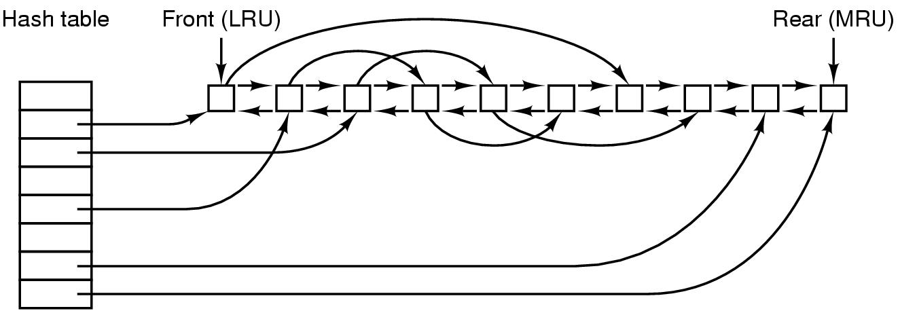
Buffer Cache

Slide 15
Buffer cache
Need to write a block?
  Modify the version in the block cache
But when should we write it back to disk?

Slide 16
Buffer cache
Need to write a block?
  Modify the version in the block cache.
But when should we write it back to disk?
  Immediately
  Later

Slide 17
Buffer cache
Need to write a block?
Modify the version in the block cache.
But when should we write it back to disk?
  Immediately
    “Write-through cache”
  Later
    The Unix “sync” syscall

Slide 18
Buffer cache
Need to write a block?
  Modify the version in the block cache.
But when should we write it back to disk?
  Immediately
    “Write-through cache”
  Later
    The Unix “sync” syscall
What if the system crashes?
Can the file system become inconsistent?

Slide 19
Buffer cache
Need to write a block?
  Modify the version in the block cache.
But when should we write it back to disk?
  Immediately
    “Write-through cache”
  Later
    The Unix “synch” syscall
What if system crashes?
Can the file system become inconsistent?
  Write directory and i-node info immediately
  Okay to delay writes to files
    Background process to write dirty blocks

Slide 20
File system performance
How does a buffer cache improve file system performance?

Slide 21
Careful data placement
Idea
  Break disk into regions
    “Cylinder Groups”
  Put blocks that are “close together” in the same cylinder group
    Try to allocate i-node and blocks in the file within the same cylinder group

Slide 22

Cylinder groups (old vs new approach)

Slide 23
File system performance
How does disk space allocation based on cylinder groups affect file system performance?

Slide 24
Log-structured file systems
Observation
  Buffer caches are getting larger
  For a “read”
    Increasing probability the block is in the cache
  The buffer cache effectively filters out most reads
Conclusion:
  Most disk I/O is “write” operations!
So how well do our file systems perform for a write-dominated workload
  Is strategy for data placement on disk appropriate?

Slide 25
Log-structured file systems
Problem:
  The need to update disk blocks “in place” forces writes to seek to the location of the block
Idea:
  Why not just write a new version of the block and modify the inode to point to that one instead
  This way we can write the block wherever the read/write head happens to be located, and avoid a seek!
But …
  Wouldn’t we have to seek to update the inode?
  Maybe we could make a new version of that too?

Slide 26
Log-structured file systems
What is a “log”?
  A log of all actions

Slide 27
Log-structured file systems
What is a “log”?
  A log of all actions
The entire disk becomes a log of disk writes

Slide 28
Log-structured file systems
What is a “log”?
  A log of all actions
The entire disk becomes a log of disk writes
Approach
  All writes are buffered in memory
  Periodically all dirty blocks are written ... to the end of the log
    The i-node is modified ... to point to the new position of the updated blocks

Slide 29
Log-structured file systems
All the disk is a log.
What happens when the disk fills up???

Slide 30
Log-structured file systems
All the disk is a log
  What happens when the disk fills up?
  How do we reclaim space for old versions of blocks?
  How do we ensure that the disk’s free space doesn’t become fragmented?
    If it did, we would have to seek to a free block every time we wanted to write anything!
  How do we ensure that the disk always has large expanses of contiguous free blocks
    If it does we can write out the log to contiguous blocks with no seek or rotational delay overhead
    Optimal disk throughput for writes

Slide 31
Log-structured file systems
A “cleaner” process
  Reads blocks in from the beginning of the log.
    Most of them will be free at this point.
  Adds non-free blocks to the buffer cache.
  These get written out to the log later.
Log data is written in units of an entire track.
The “cleaner” process reads an entire track at a time.
  Efficient

Slide 32
File system performance
How do log structured file systems improve file system performance?

Slide 33
Disk space management
Must choose a disk block size...
  = Page Size?
  = Sector Size?
  = Track size?

Slide 34
Disk space management
Must choose a disk block size...
  = Page Size?
  = Sector Size?
  = Track size?
Large block sizes:
  Internal fragmentation
  Last block has (on average) 1/2 wasted space
  Lots of very small files; waste is greater.

Slide 35
Disk space management
Must choose a disk block size...
  = Page Size?
  = Sector Size?
  = Track size?
Large block sizes:
  Internal fragmentation
  Last block has (on average) 1/2 wasted space
  Lots of very small files; waste is greater.
Small block sizes:
  More seeks; file access will be slower.

Slide 36
Block size tradeoff
Smaller block size?
  Better disk utilization
  Poor performance
Larger block size?
  Lower disk space utilization
  Better performance

Slide 37
Example
A Unix System
  1000 users, 1M files
  Median file size = 1,680 bytes
  Mean file size = 10,845 bytes
  Many small files, a few really large files

Slide 38
Example
A Unix System
  1000 users, 1M files
  Median file size = 1,680 bytes
  Mean file size = 10,845 bytes
  Many small files, a few really large files
Let’s assume all files are 2 KB...
  What happens with different block sizes?
  (The tradeoff will depend on details of disk performance.)

Slide 39
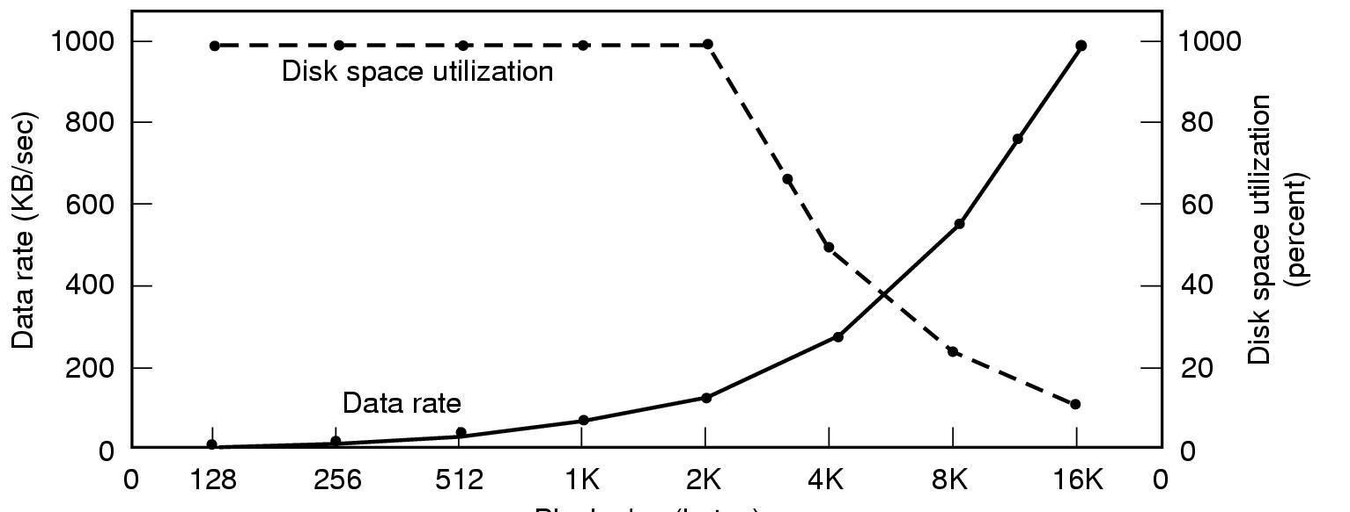
Block size tradeoff
sd
Block size
Assumption: All files are 2K bytes
Given: Physical disk properties
Seek time=10 msec
Transfer rate=15 Mbytes/sec
Rotational Delay=8.33 msec * 1/2

Slide 40
Managing free blocks
Approach #1:
  Keep a bitmap
  1 bit per disk block
Approach #2
  Keep a free list

Slide 41
Managing free blocks
Approach #1:
  Keep a bitmap
  1 bit per disk block
    Example:
      1 KB block size
      16 GB Disk ⇒ 16M blocks = 2²⁴ blocks
    Bitmap size = 2²⁴ bits ⇒ 2K blocks
      1/8192 space lost to bitmap
Approach #2
  Keep a free list

Slide 42
Free list of disk blocks
Linked List of Free Blocks
Each block on disk holds
  A bunch of addresses of free blocks
  Address of next block in the list
null

Slide 43
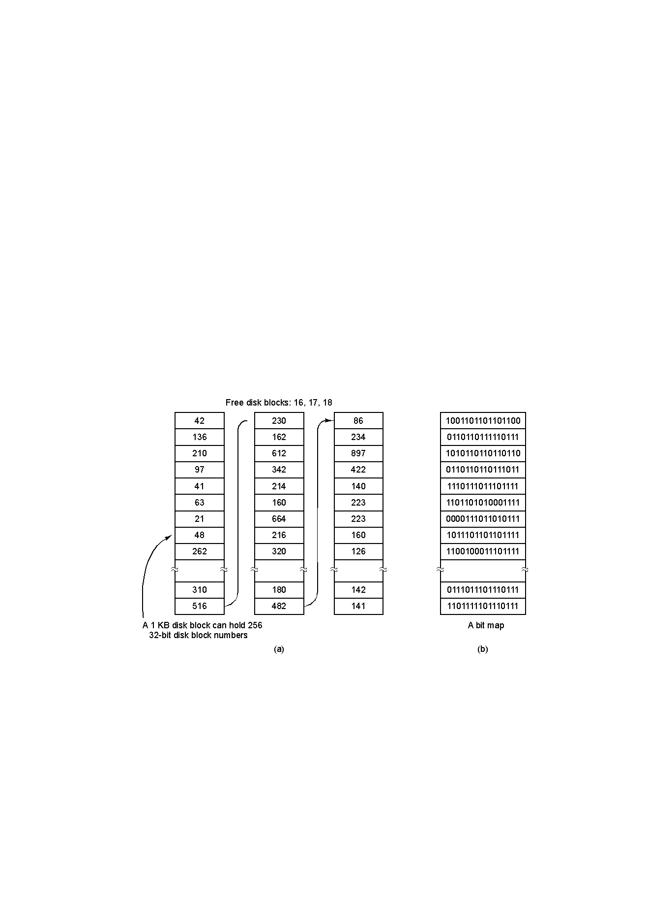
Free list of disk blocks
asd
Assumptions:
Block size = 1K
Each block addr = 4bytes
Each block holds
255 ptrs to free blocks
1 ptr to the next block
This approach takes more space...
But “free” blocks are used, so no real loss!

Slide 44
Free list of disk blocks
Two kinds of blocks:
  Free Blocks
  Block containing pointers to free blocks
Always keep one block of pointers in memory.
This block may be partially full.
Need a free block?
  This block gives access to 255 free blocks.
  Need more?
    Look at the block’s “next” pointer
    Use the pointer block itself
    Read in the next block of pointers into memory

Slide 45
Free list of disk blocks
To return a block (X) to the free list...
  If the block of pointers (in memory) is not full:
    Add X to it

Slide 46
Free list of disk blocks
To return a block (X) to the free list…
  If the block of pointers (in memory) is not full:
    Add X to it
  If the block of pointers (in memory) is full:
    Write it to out to the disk
    Start a new block in memory
    Use block X itself for a pointer block
      All empty pointers
      Except the next pointer

Slide 47
Free list of disk blocks
Scenario:
  Assume the block of pointers in memory is almost empty.
  A few free blocks are needed.

Slide 48
Free list of disk blocks
Scenario:
  Assume the block of pointers in memory is almost empty.
  A few free blocks are needed.
    This triggers disk read to get next pointer block
  Now the block in memory is almost full.

Slide 49
Free list of disk blocks
Scenario:
  Assume the block of pointers in memory is almost empty.
  A few free blocks are needed.
    This triggers disk read to get next pointer block
  Now the block in memory is almost full.
  Next, a few blocks are freed.

Slide 50
Free list of disk blocks
Scenario:
  Assume the block of pointers in memory is almost empty.
  A few free blocks are needed.
    This triggers disk read to get next pointer block
  Now the block in memory is almost full.
  Next, a few blocks are freed.
  The block fills up
    This triggers a disk write of the block of pointers.

Slide 51
Free list of disk blocks
Scenario:
  Assume the block of pointers in memory is almost empty.
  A few free blocks are needed.
    This triggers disk read to get next pointer block
  Now the block in memory is almost full.
  Next, a few blocks are freed.
  The block fills up
    This triggers a disk write of the block of pointers.
Problem:
  Numerous small allocates and frees, when block of pointers is right at boundary
  Lots of disk I/O associated with free block mgmt!

Slide 52
Free list of disk blocks
Solution (in text):
  Try to keep the block in memory about 1/2 full
  When the block in memory fills up...
    Break it into 2 blocks (each 1/2 full)
    Write one out to disk
Similar Algorithm:
  Keep 2 blocks of pointers in memory at all times.
  When both fill up
    Write out one.
  When both become empty
  Read in one new block of pointers.

Slide 53
Comparison: free list vs bitmap
Desirable:
  Keep all the blocks in one file close together.

Slide 54
Comparison: free list vs bitmap
Desirable:
  Keep all the blocks in one file close together.
Free Lists:
  Free blocks are all over the disk.
  Allocation comes from (almost) random location.

Slide 55
Comparison: free list v. bitmap
Desirable:
  Keep all the blocks in one file close together.
Free Lists:
  Free blocks are all over the disk.
  Allocation comes from (almost) random location.
Bitmap:
  Much easier to find a free block “close to” a given position
  Bitmap implementation:
    Keep 2 MByte bitmap in memory
    Keep only one block of bitmap in memory at a time

Slide 56
Quotas
For each user...
  OS will maintain a record.
  Example:
    Amount of disk space used (in blocks)
      Current
      Maximum allowable
    Number of files
      Current
      Maximum allowable
Soft Limits:
  When exceeded, print a warning
Hard Limits:
  May not be exceeded

Slide 57
Backing up a file system
“Incremental” Dumps
  Example:
    Once a month, back up the entire file system
    Once a day, make a copy of all files that have changed
Why?
  Faster!
To restore entire file system...
  1. Restore from complete dump
  2. Process each incremental dump in order

Slide 58
Backing up
“Physical Dump”
  Start a block 0 on the disk
  Copy each block, in order

Slide 59
Backing up
“Physical Dump”
  Start a block 0 on the disk
  Copy each block, in order
Blocks on the free list?
  Should avoid copying them

Slide 60
Backing up
“Physical Dump”
  Start a block 0 on the disk
  Copy each block, in order
Blocks on the free list?
  Should avoid copying them
Bad sectors on disk?
  Controller remaps bad sectors:
  Backup utility need not do anything special!
    OS handles bad sectors:
    Backup utility must avoid copying them!

Slide 61
Backing up
“Logical Dump”
  Dump files and directories
  (Most common form)
Incremental dumping of files and directories:
  Will copy only files that have been modified since last incremental backup.
  Must also copy the directories containing any modified files.

Slide 62
Incremental backup of files
Determine which files
have been modified
/
A
B
C
i
D
j
E
F
k
l
m
n
G
H
o
p
q
r

Slide 63
Incremental backup of files
Determine which files
have been modified
/
A
B
C
i
D
j
E
F
k
l
m
n
G
H
o
p
q
r

Slide 64
Incremental backup of files
Which directories must
be copied?
/
A
B
C
i
D
j
E
F
k
l
m
n
G
H
o
p
q
r

Slide 65
Incremental backup of files
Which directories must
be copied?
/
A
B
C
i
D
j
E
F
k
l
m
n
G
H
o
p
q
r

Slide 66
Incremental backup of files
Which directories must
be copied?
/
A
B
C
i
D
j
E
F
k
l
m
n
G
H
o
p
q
r

Slide 67
Incremental backup of files
Copy only these
/
A
B
C
i
D
j
E
F
k
l
m
n
G
H
o
p
q
r

Slide 68
Incremental backup of files
Copy only these
/
A
B
C
i
D
j
E
F
k
l
m
n
G
H
o
p
q
r

Slide 69
Recycle bins
Goal:
  Help the user to avoid losing data.
Common Problem:
  User deletes a file and then regrets it.
Solution:
  Move all deleted files to a “garbage” directory.
  User must “empty the garbage” explicitly.
This is only a partial solution;
  May still need recourse to backup tapes.

Slide 70
File system consistency
Invariant:
  Each disk block must be
    in a file (or directory), or
    on the free list

Slide 71
File system consistency
Inconsistent States:

Slide 72
File system consistency
Inconsistent States:
  Some block is not in a file or on free list (“missing block”)

Slide 73
File system consistency
Inconsistent States:
  Some block is not in a file or on free list (“missing block”)
  Some block is on free list and is in some file

Slide 74
File system consistency
Inconsistent States:
  Some block is not in a file or on free list (“missing block”)
  Some block is on free list and is in some file
  Some block is on the free list more than once

Slide 75
File system consistency
Inconsistent States:
  Some block is not in a file or on free list (“missing block”)
  Some block is on free list and is in some file
  Some block is on the free list more than once
  Some block is in more than one file

Slide 76
File system consistency
Inconsistent States:
  Some block is not in a file or on free list (“missing block”)
    Add it to the free list.
  Some block is on free list and is in some file
  Some block is on the free list more than once
  Some block is in more than one file

Slide 77
File system consistency
Inconsistent States:
  Some block is not in a file or on free list (“missing block”)
    Add it to the free list.
  Some block is on free list and is in some file
    Remove it from the free list.
  Some block is on the free list more than once
  Some block is in more than one file

Slide 78
File system consistency
Inconsistent States:
  Some block is not in a file or on free list (“missing block”)
    Add it to the free list.
  Some block is on free list and is in some file
    Remove it from the free list.
  Some block is on the free list more than once
    (Can’t happen when using a bitmap for free blocks.)
    Fix the free list so the block appears only once.
  Some block is in more than one file

Slide 79
File system consistency
Inconsistent States:
  Some block is not in a file or on free list (“missing block”)
    Add it to the free list.
  Some block is on free list and is in some file
    Remove it from the free list.
  Some block is on the free list more than once
    (Can’t happen when using a bitmap for free blocks.)
    Fix the free list so the block appears only once.
  Some block is in more than one file
    Allocate another block.
    Copy the block.
    Put each block in each file.
    Notify the user that one file may contain data from another file.

Slide 80
File system consistency - reference counts
Invariant (for Unix):
“The reference count in each i-node must be equal to the number of hard links to the file.”
D1:
D2:
D3:
A
B
C
X
Y
F
G
C
File

Slide 81
File system consistency - reference counts
Problems:
  Reference count is too large
  Reference count is too small

Slide 82
File system consistency - reference counts
Problems:
  Reference count is too large
    The “rm” command will delete a hard link.
    When the count becomes zero, the blocks are freed.
    Permanently allocated; blocks can never be reused.
  Reference count is too small

Slide 83
File system consistency - reference counts
Problems:
  Reference count is too large
    The “rm” command will delete a hard link.
    When the count becomes zero, the blocks are freed.
    Permanently allocated; blocks can never be reused.
  Reference count is too small
    When links are removed, the count will go to zero too soon!
    The blocks will be added to the free list, even though the file is still in some directory!

Slide 84
File system consistency - reference counts
Problems:
  Reference count is too large
    The “rm” command will delete a hard link.
    When the count becomes zero, the blocks are freed.
    Permanently allocated; blocks can never be reused.
  Reference count is too small
    When links are removed, the count will go to zero too soon!
    The blocks will be added to the free list, even though the file is still in some directory!
Solution:
  Correct the reference count.

